Slide 1
Lab 5d SDS-PAGE

Slide 2
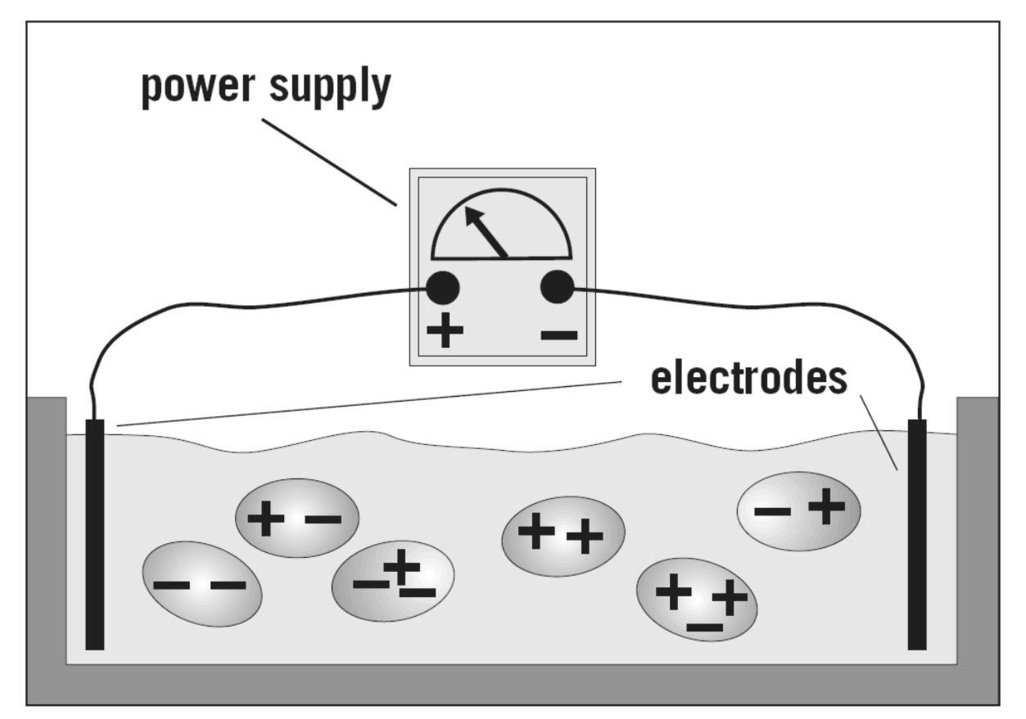
Electrophoresis
Separates molecules based on molecular mass and/or charge.
Proteins move in the electric field. Their relative speed depends on the charge, size, and shape of the protein

Slide 3
What is so special about SDS?
SDS is a negatively charged detergent.
Disrupts secondary and tertiary protein structures by breaking hydrogen bonds and unfolding protein.
‘Masks’ charge on protein so that all proteins act the same as regards charge.
Prevents protein aggregation.
Prevents protein shape from influencing gel run.
Notes:
Must have a major role since the technique is named after it!

Slide 4
Uses of SDS-PAGE
Determine protein size
Identify protein
Determine sample purity
Identify existence of disulfide bonds
Quantify amounts of protein

Slide 5
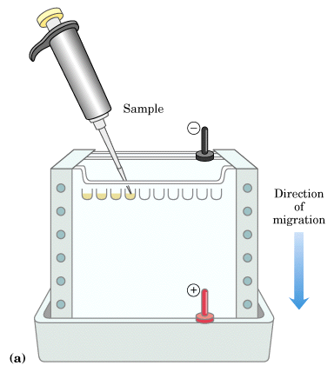
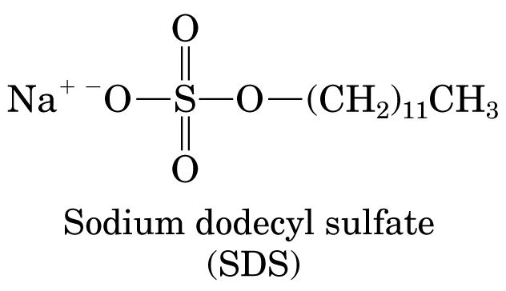
Electrophoresis
Electrophoresis is based on the migration of proteins in a charged field.
The force moving the macromolecules is the electrical potential, E.
µ = V/E, where µ is the electrophoretic mobility, and V is the velocity of the particle.
µ = Z/f, where Z is the net charge of the molecule, and f is the frictional coefficient. f is related to the the shape of the molecule, as well as its size.
Typically, the cross-linked polymer, polyacrylamide acts as the solid support. Normally, proteins would be separated in proportion to their charge-to mass ratio. The problem is that some proteins would migrate towards the anode, while others would migrate toward the cathode; and, the migration would not reflect size, but charge to mass.
The trick is to carry out the electrophoresis in the presence of sodium docecyl sulfate, which is a detergent.
SDS binds to every protein in roughly the same proportion, which is about one molecule for every two amino acid residues. SDS carries with it a negative charge, and the cumulative negative charge renders the intrinsic net charge of the protein insiginificant.
Therefore, every protein will have the same charge to mass ratio, which will cause all proteins to migrate towards the cathode with a rathe that is dependent on their sizes.
In contrast to gel-filtration, smaller molecules migrate faster than larger molecules
Typically, this technique is not used to purify proteins, because SDS normally denatures proteins. It is used to analyze the purity of proteins.

Slide 6
What is SDS-PAGE?
0
SDS - Sodium Dodecyl Sulfate
PAGE - Polyacrylamide Gel Electrophoresis
Method commonly used in molecular biology for the separation of proteins.
Determines the molecular weight of proteins and also approximates the length of a polypeptide.
Gels after SDS-PAGE may be used in
  Coomassie staining technique
  Western blot

Slide 7
SDS-PAGE
SDS breaks up hydrophobic areas and coats proteins with negative charges thus overwhelming positive charges in the protein.
The detergent binds to hydrophobic regions in a constant ratio of about 1.4 g of SDS per gram of protein.
The end result has two important features: 1) all proteins contain only primary structure and 2) all proteins have a large negative charge which means they will all migrate towards the positive pole when placed in an electric field.
Before proteins are applied to the gel they are also exposed to a disulfide bond reducing agent, mercaptoethanol. The mercaptoethanol assists in protein denaturation by reducing all disulfide bonds.

Slide 8
Formation of Gel
Polyacrylamide gels are prepared by free radical polymerization of acrylamide and the cross linking agent N,N’-methylene-bis-acrylamide. Chemical polymerization is controlled by an initiator catalyst system, N,N,N’,N’-tetramethylethylenediamine (TEMED)
The copolymerization of acrylamide with methylenebisacrylamide produces a mesh-like network in three dimensions, consisting of acrylamide chains with interconnections formed from the methylenebisacrylamide.

Slide 9
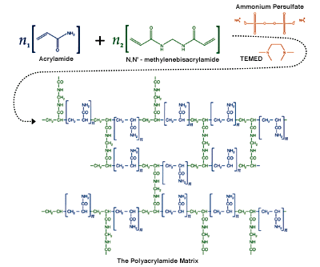

Slide 10
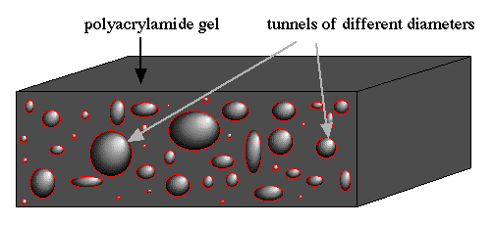
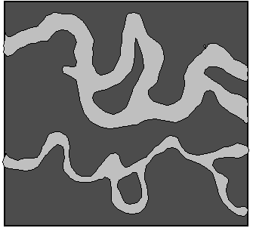
SDS PAGE Movement
Tunnels Are formed in the PAGE Gel.
These Tunnels Vary In size and will separate the molecules when they travel through the gel.

Slide 11
Polyacrylamide Gel
0
Two types of gel make up the SDS-PAGE method
  Separating Gel
    Separating gel has a higher pH (~8.8) and also has a higher concentraion of acrylamide for narrower pores.
    10 % Separating gel contained acrylamide that was polymerized by TEMED to form the actual gel.
      TEMED is an agent used with ammonium persulfate to catalyze the polymerization reaction of acrylamide.
      Acrylamide in liquid form is a powerful neurotoxin that can be absorbed through the skin.
  Stacking Gel
    Slightly more acidic (~pH 6.8) and contains less acrylamide.
    Bigger pores.

Slide 12
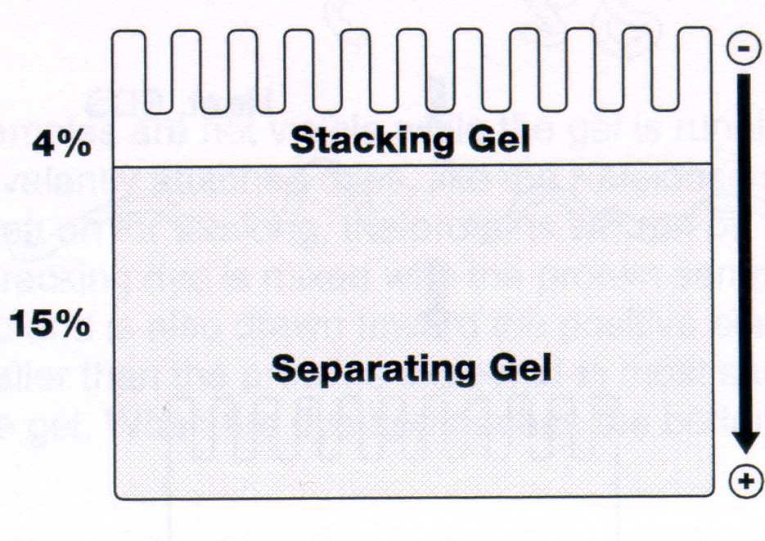
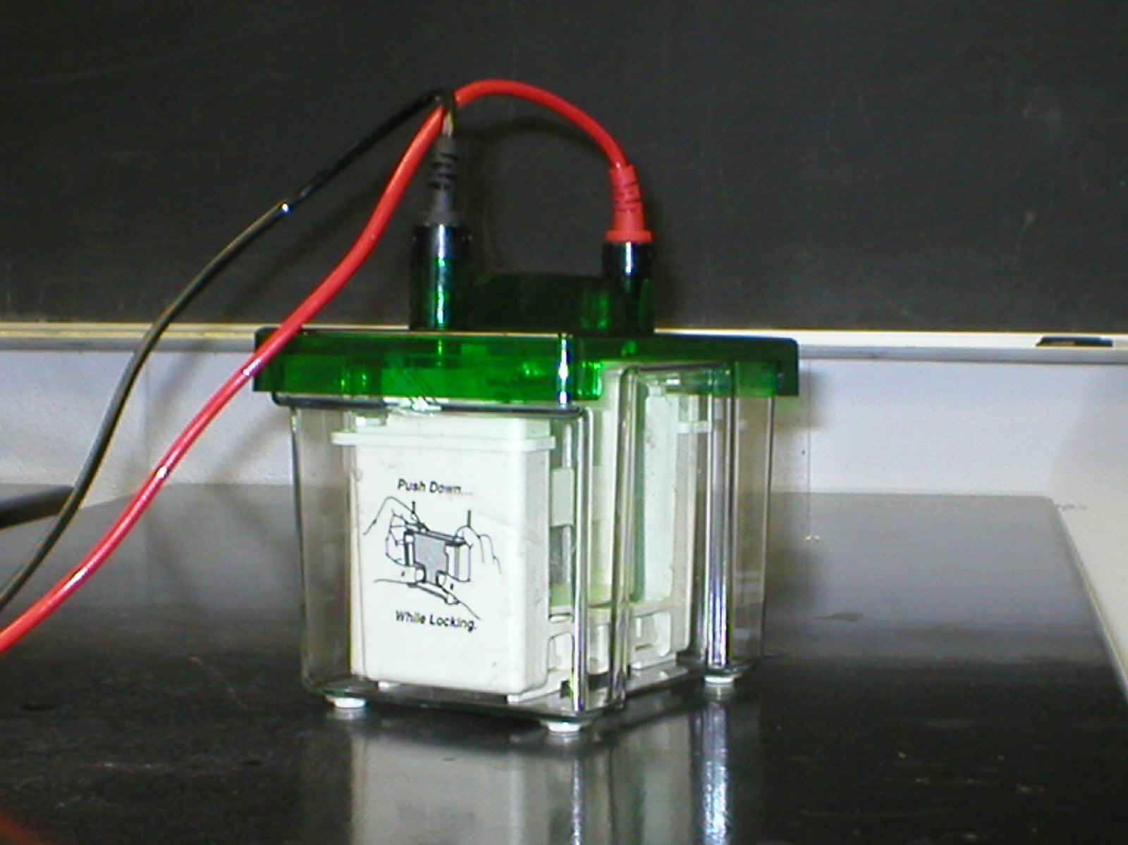
Polyacrylamide Gel
Cathode
Anode
Proteins separated by molecular weight

Slide 13
Stacking Gel
To obtain optimal resolution of proteins, a “stacking” gel is poured over the top of the “resolving” gel.
The stacking gel
  lower concentration of acrylamide (larger pore size),
  lower pH
  different ionic content
This allows the proteins in a lane to be concentrated into a tight band before entering the running or resolving gel
produces a gel with tighter or better separated protein bands

Slide 14
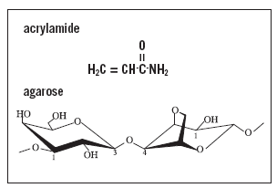
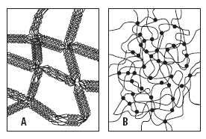
Gels
Polymerization, T%, C%

Slide 15
Procedures
0
Prepare polyacrylamide gels (separating and stacking gels)
Load protein samples into wells
Run gel
Analysis of results by staining with Coomassie blue or Western Blot

Slide 16
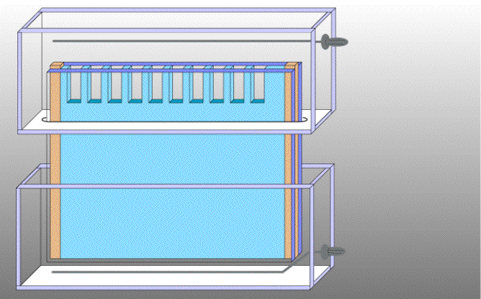
Setting Up a Vertical Gel
Cathode
Upper buffer
Compartments
Gel cassette
Lower buffer
Compartments
Anode
Notes:
A completed slab gel is open at top and bottom, to permit introduction of samples into the wells and to allow communication with an upper negatively charged electrode (cathode) and lower electrode ( the anode). To make the lower connection the bottom of the gel is immersed in a compartment containing electrode buffer and the anode. The upper part of the gel is sealed into a compartment containing the cathode, so that the upper opening is also in contact with electrode buffer. In SDS-PAGE the electrode buffer is a Trizma/glycine solution containing SDS.
Why the need for electrode buffer? In electronic instrumentation charge is conducted by electrons, while in the gel charge is conducted by ions. To convert from electron movement to ion movement we make electrodes from a highly catalytic metal such as platinum. A negatively charged platinum electrode (cathode) readily boils off electrons while one carrying positive charge (anode) readily accepts them. Thus a pair of platinum electrodes can conduct electricity from a power supply through an aqueous solution and/or gel.
Buffer compartments provide a uniform electric field when running the gel, so that all samples experience the same voltage difference. Additionally, in SDS-PAGE the electrode buffer contains a high concentration of glycine, which is essential for the stacking effect to take place.

Slide 17
The Electrophoresis Matrix
In gel electrophoresis the matrix forces sample components to separate by size, as they move through its porous structure. The matrix provides greater resistance to the movement of larger molecules.
the matrix serves as a solid medium upon which samples can be fixed and detected in post-electrophoretic analysis.

Slide 18
Fixing Proteins on Electrophoresis Gels
Most protein gels can be fixed effectively by soaking for 1 hr in 45% methanol, 45% water, and 10% glacial acetic acid. This solution is stable for up to 30 days at room temperature. A more stable fixative is 25% isopropanol, 65% water and 10% acetic acid, which can be stored at 4°C for up to 4 months.

Slide 19
Staining Proteins in Gels
Chemical stains detect proteins based on differential binding of the stain by the protein molecules and the gel matrix. They are nonspecific in action, detecting proteins without regard to their individual identities. The important characteristics for a useful stain are: low background, high sensitivity, large linear range and ease of use.

Slide 20
Protein visualization on gels
Immediately after electrophoresis proteins in the gels are precipitated by either adding alcohol containing solutions or strong acids (e.g. TCA).
Protein are often stained by Coomassie Blue dye or by photography-like treatment with AgNO₃ (silver staining)
There are many other stains available (e.g. Stains-all, fluorescence probes etc.)

Slide 21
Coomassie Stain
0
Coomassie Brilliant Blue Stain
  40% Methanol
  0.125% Coomassie G-250
  10% Acetic Acid
Destaining Solution
  40% Methanol
  10% Acetic Acid
Protocol
  After SDS-PAGE, the gel is transferred into a plastic container
  Coomassie staining solution was poured onto the gel, and it was incubated at room temperature for 2 hours with shaking.
  The gel was then destained with destaining buffer. Kimwipes were placed in the container to help absorbe the coomassie stain.
  After destaining, the gel was dried in drying film.

Slide 22
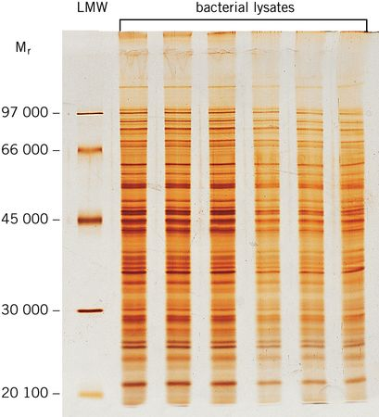
Example of Silver Stained Gel
Silver staining is usually 10-100 times more sensitive than Coomassie Blue staining, but it is more complicated.
Faint but still visible bands on this gel contain less than 0.5 ng of protein!

Slide 23
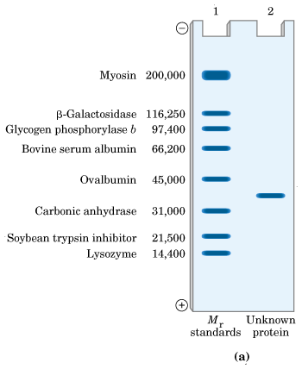
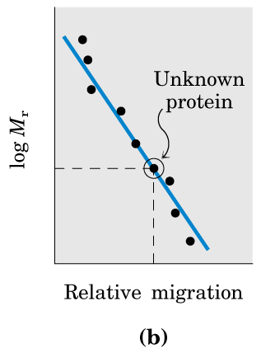
Molecular Weight Determination
Shown above (on the left) is an SDS-polyacrylamide gel that has been stained with a dye in order to view the proteins. Lane one of the left figure represents a set of standards, while lane 2 represents a protein that has been purified. The molecular weight M_{r} of the protein can be estimated, by comparing its relative migration to that of the standards. The relation is that the relative migration is dependent on the log of the molecular weight.

Slide 24
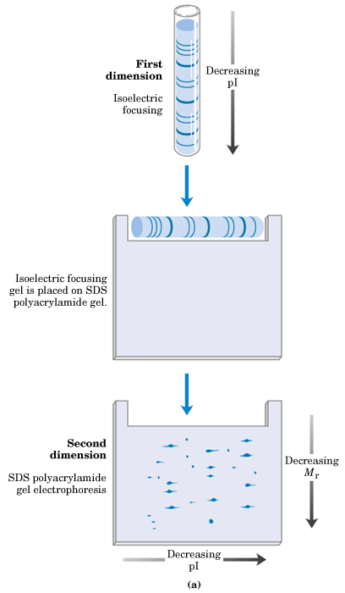
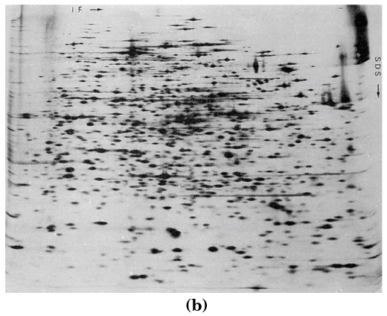
2D-Electrophoresis
2D-electrophoresis allows separation of proteins by both size and isoelectric point. Each spot represents a different protein. The horizontal represents the isoelectric focusing direction, while the veritcal represents the SDS PAGE direction.

Slide 25
Protein Gel Electrophoresis
Native PAGE
Native Gradient PAGE
Urea PAGE
SDS PAGE
SDS Gradient PAGE
IEF
2D PAGE
Western Blot

Slide 26
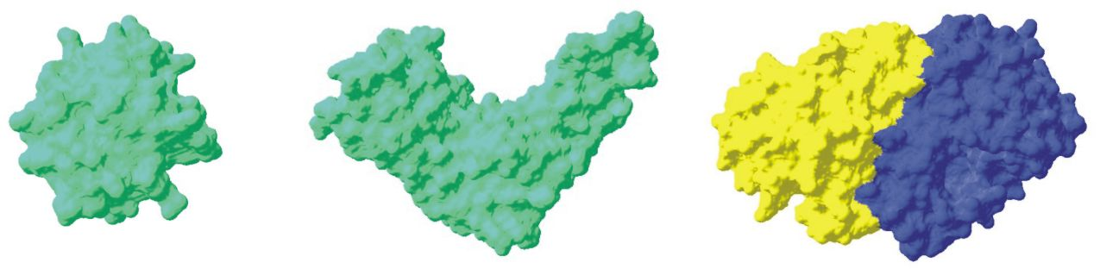
Native PAGE
Separates folded proteins and protein-protein or protein-ligand complexes by charge, size, and shape
Useful for:
Examining protein-protein, protein-ligand interactions
Detecting protein isoforms/conformers

Slide 27
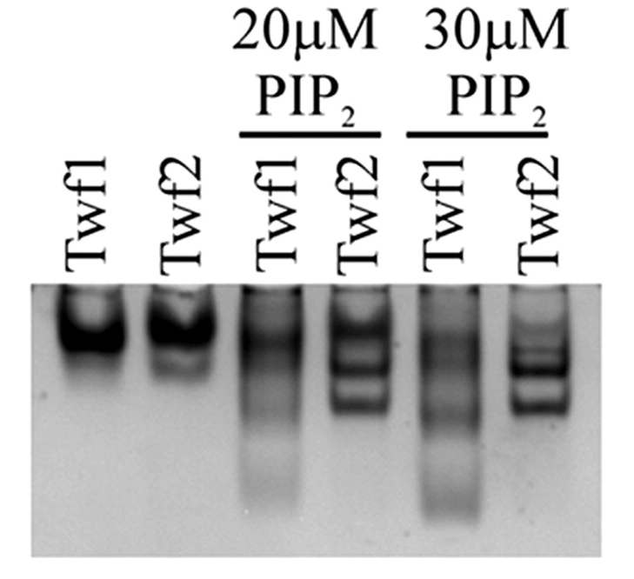
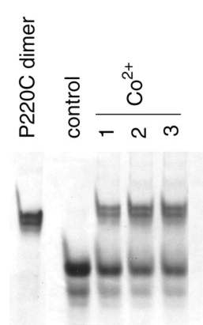
Native PAGE Examples
In the absence of phospholipids, both twinfilins run as a single sharp band on this gel. PI(4,5)P2 causes twinfilin-1 and twinfilin-2 to move more rapidly toward the anode, indicating a net increase in the negative charge and thus a binding interaction.
Dimerization of KIR2DL1 in the presence of Co2
Vartiainen et al. JBC 2003
Qing R. Fan et al. JBC 2000

Slide 28
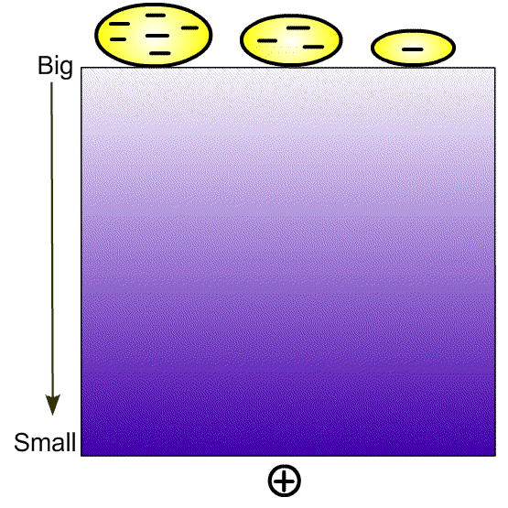
Native Gradient PAGE
Separate native proteins by size – proteins stop moving when they reach a certain gel density (but this may take a very long time ...)
A great technique to study protien oligomerization!

Slide 29
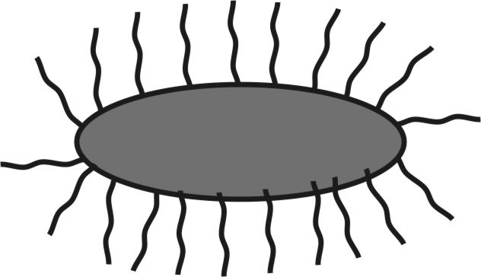
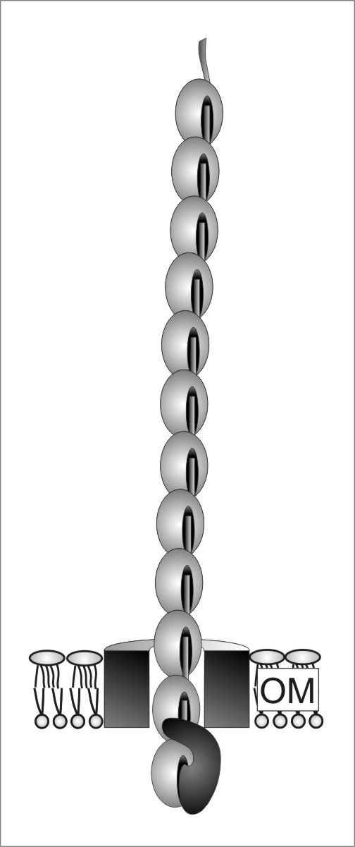
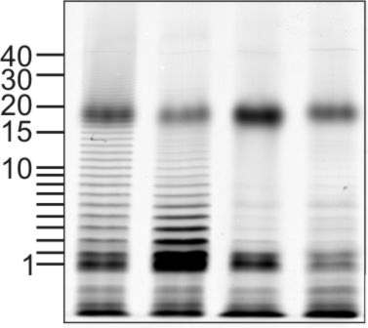
Native Gradient PAGE Example
Native 4-15% gradient PAGE
Zavialov et al. Mol. Microbiol. 2002

Slide 30
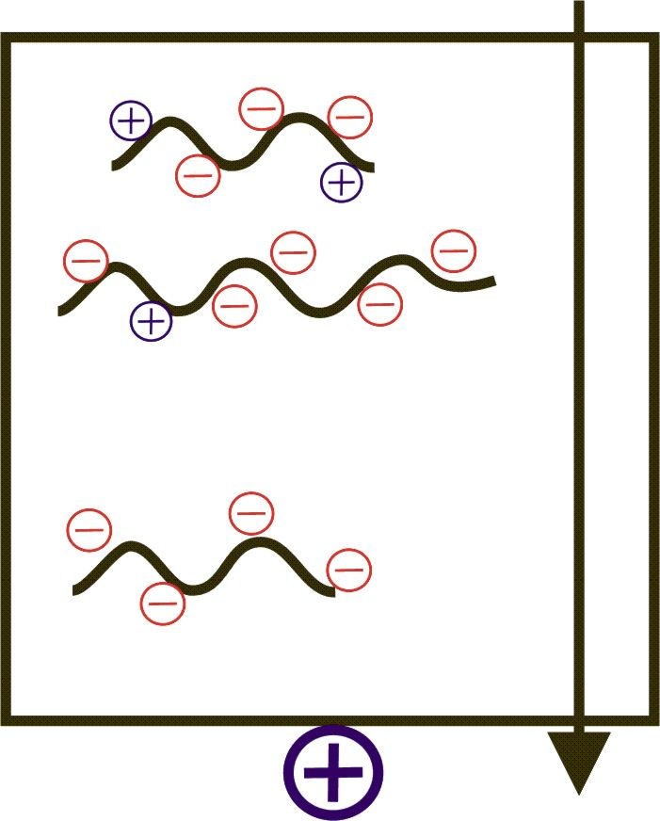
Urea PAGE
Separates denatured proteins by size/charge
Typically 6-8 M urea is added into the gel
A great technique to study protein modifications!

Slide 31
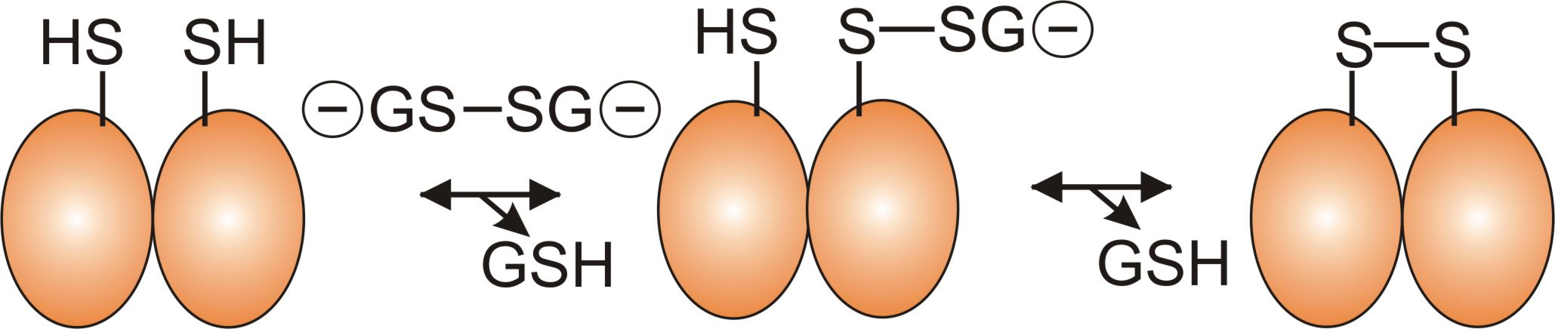
Example of Urea PAGE
Urea PAGE of samples of heat shock protein 25
Zavialov et al. BBA 1998

Slide 32
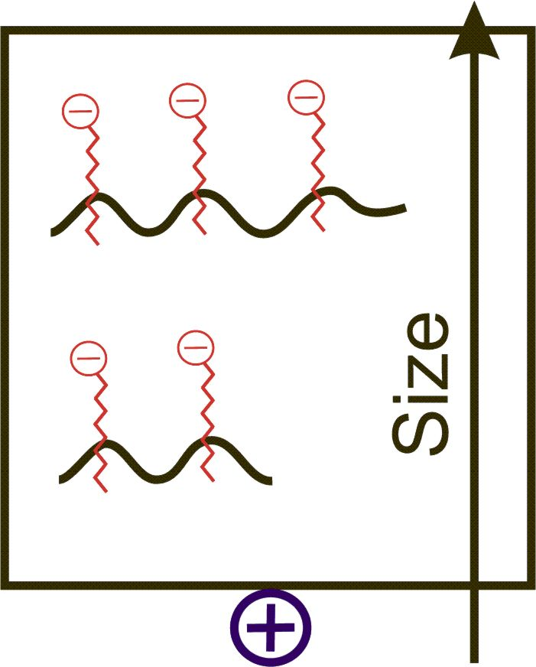
SDS PAGE
Due to high density of binding of SDS to proteins, the ratio size/charge is nearly the same for many SDS denatured proteins. Hence proteins are separated only by length of their polypeptide chains (but not by differences in charge).
Great separation. Allows estimation of the size of polypeptide chains

Slide 33
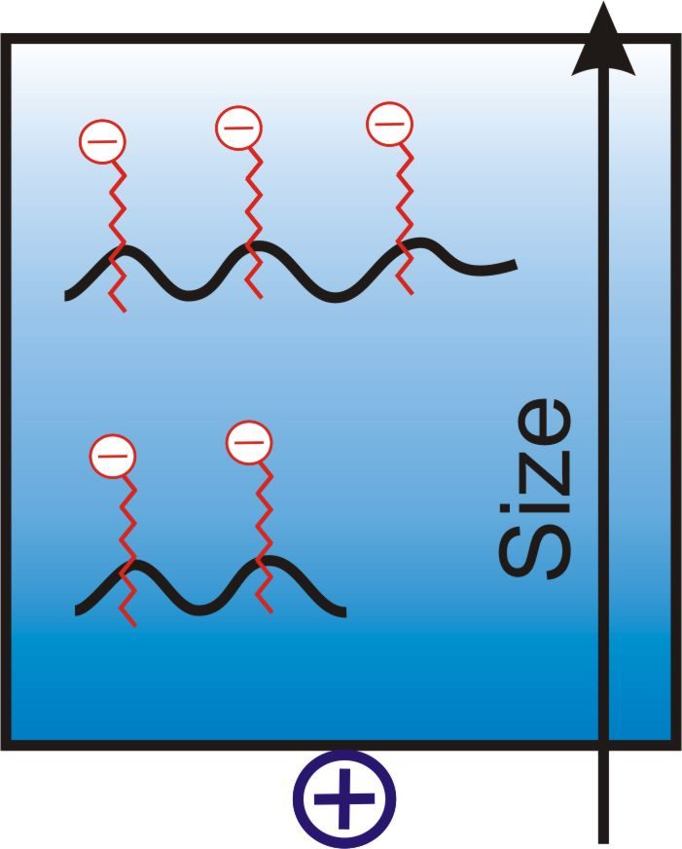
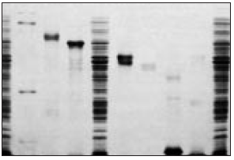
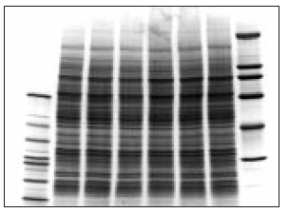
SDS Gradient PAGE
12.5% SDS PAGE
Bands in SDS gradient gel are usually sharper than in homogeneous SDS PAGE
5-20% SDS PAGE

Slide 34
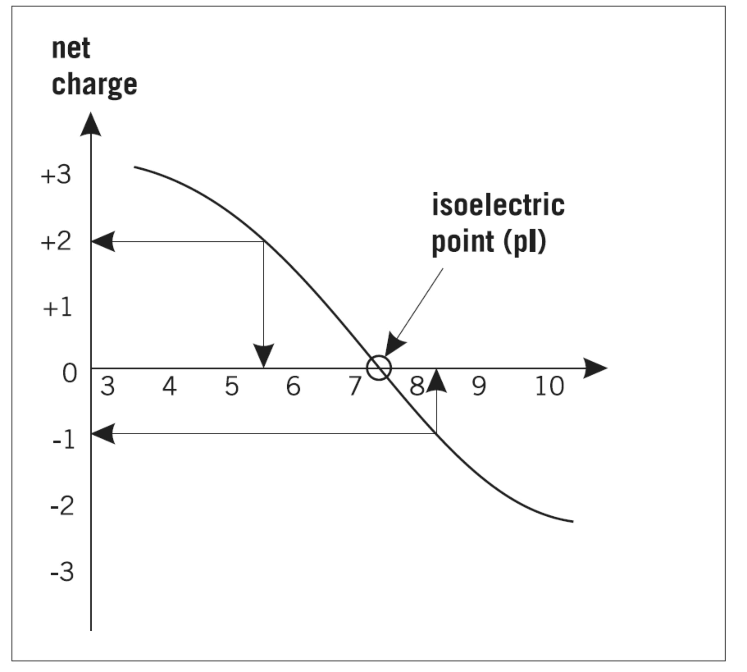
Isoelectric Focusing
Separates proteins by their isoelectric points (pI)
Each protein has own pI = pH at which the protein has equal amount of positive and negative charges (the net charge is zero)

Slide 35
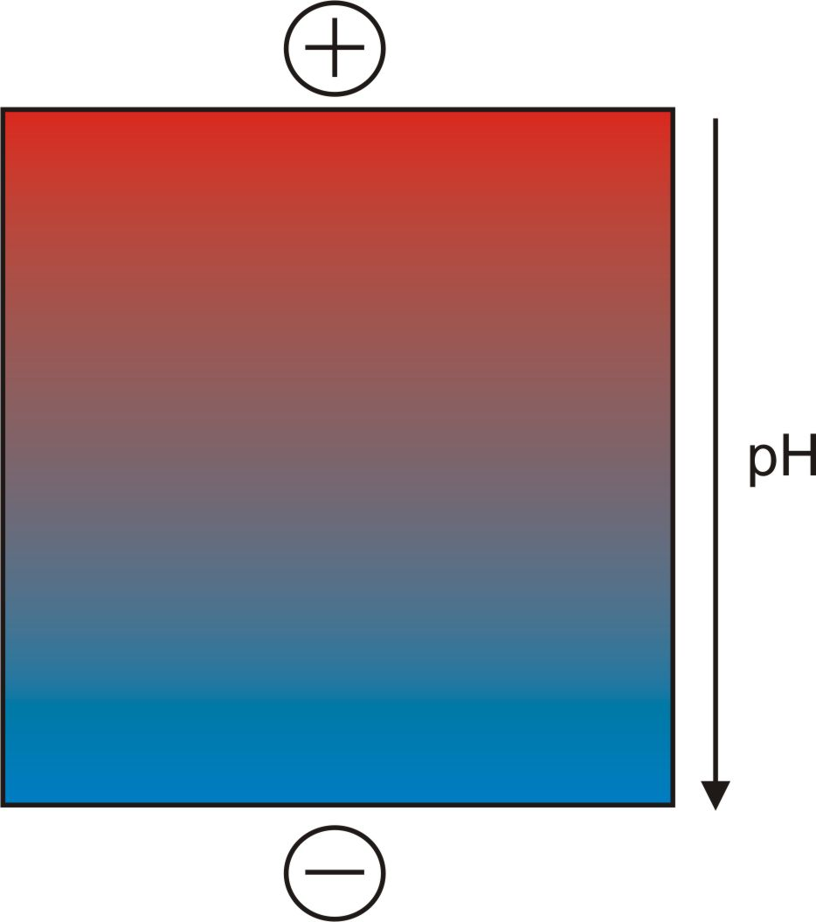
Isoelectric Focusing
Mixtures of ampholytes, small amphoteric molecules with high buffering capacity near their pI, are used to generate the pH gradient.
Positively and negatively charged proteins move to – and +, respectively, until they reach pI.
PI of proteins can be theoretically predicted. Therefore, IEF can also be used for protein identification.

Slide 36
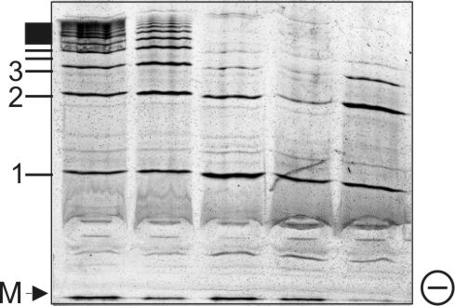
Isoelectric Focusing
IEF 4-6.5 pH gradient

Slide 37
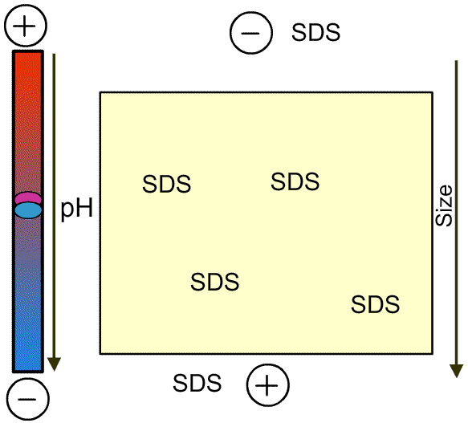
2D PAGE

Slide 38
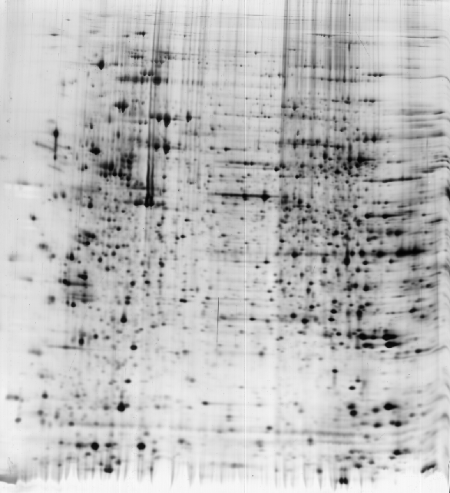
2D PAGE
Lung V79 cells from chinese hamster

Slide 39
Western Blotting (WB)
WB is a protein detection technique that combines the separation power of SDS PAGE together with high recognition specificity of antibodies
An antibody against the target protein could be purified from serum of animals (mice, rabbits, goats) immunized with this protein
Alternatively, if protein contains a commonly used tag or epitope, an antibody against the tag/epitope could be purchase from a commercial source (e.g. anti-6 His antibody)

Slide 40
WB: 4 Steps
Separation of proteins using SDS PAGE
2. Transfer of the proteins onto e.g. a nitrocellulose membrane (blotting)
3. Immune reactions
4. Visualization

Slide 41
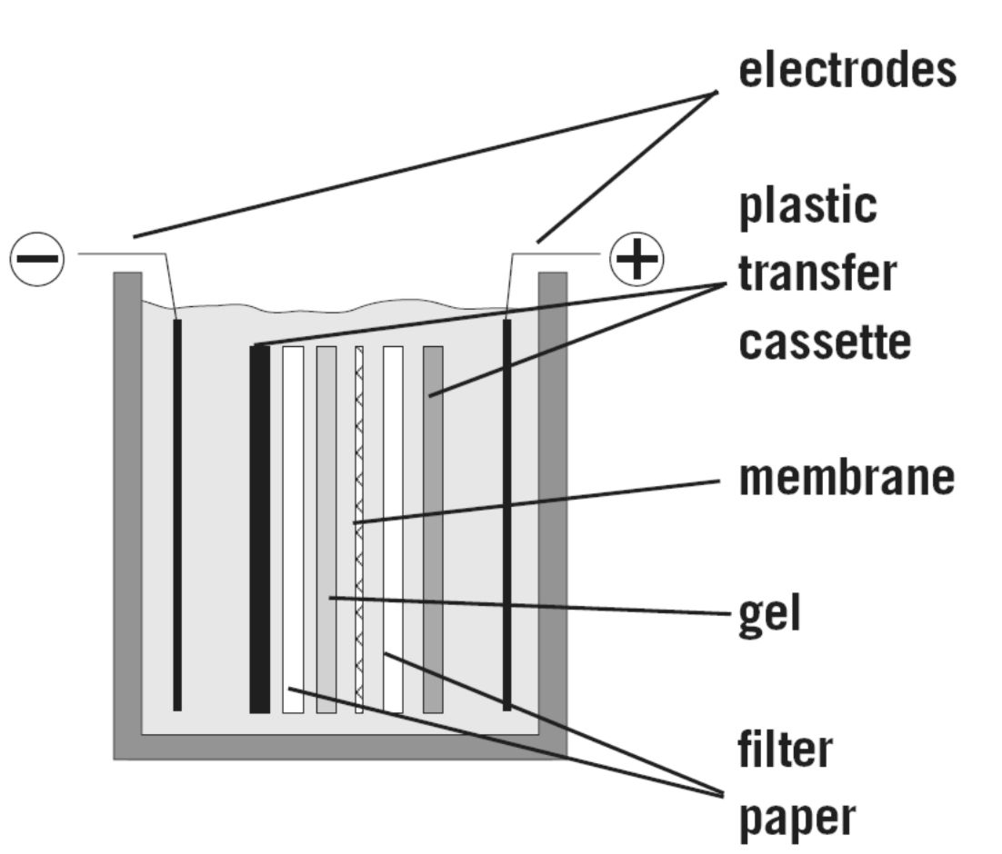
WB, Step 2: Blotting

Slide 42
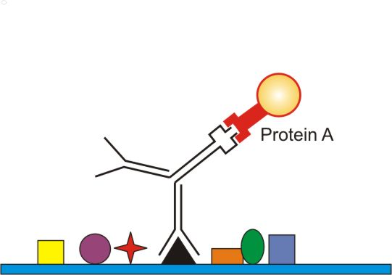
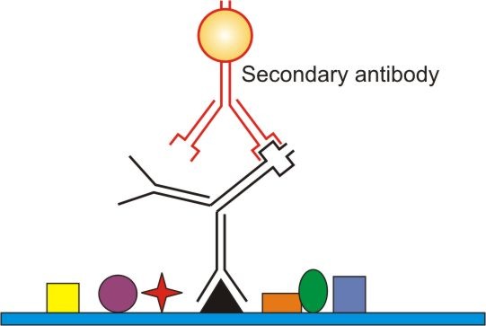
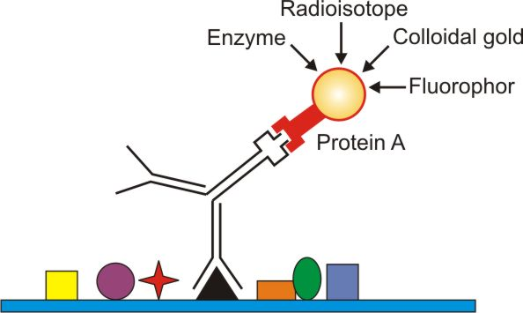
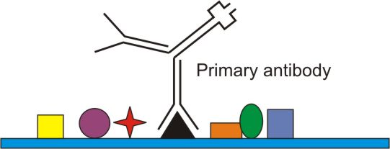

WB, Steps 3-4: Detection

Slide 43
Assess purity – screen 2
Standards | Crude Ext.| Pooled
fractions
  Look at it on a gel. A monomer should have one band.
  Calculate the specific activity by doing a careful quantitative assay for enzyme activity/total protein.
Purification Table
Procedure | Fraction vol (ml) | Total Prot (mg) | Activity (units) | Specific activity Units/mg
Crude cellular extract | 1400 | 10000 | 100000 | 10
Separation method 1 | 90 | 400 | 80000 | 200
Separation method 2 | 8 | 4 | 60000 | 15000
Results:
Gel shows one band
Specific activity is 15000.
Looks good
Your protein seems pure. YOU’RE DONE!!!.
Notes:
After clicking “another separation”, another separation is virtually done and another lane on the gel is visible and another row of the purification table is filled out.

Slide 44
Applications
0
SDS-PAGE
  Isolation of protein
  Approximating the length of a polypeptide
  Determining the molecular weight of protein bands

Slide 45
Logarithmic scale graph
Trendline is exponential, but on this type of graph it appears linear

Slide 46
Requirement for Report
Measure all the distance that protein spots travel, and convert the distance to corresponding relative mobility
Tabulate all the distances, relative mobility.
Graph the relative mobility vs log MW
Estimate the molecular weight of protein spots in F1, F2, and F3 and compare their relative intensity

